Slide 1

ID Card Generator
A C++ Application with Open CV and File system Integration
Presented by:
Aaditya Kumar Karn
Anuj Kumar Thakur
^{Bikash Bist}

Slide 2

Agenda
This presentation outlines the architecture and functionality of our C++ ID card generation application, highlighting its modular design and future potential.
Project Overview
Core Components
Understand the core purpose and key features.
Dive into the C++ classes and their responsibilities.
Open CV Integration
File system Management
Explore image capture and card rendering.
Learn about data persistence and organization.
Input Validation
Future Scope
Examine robust data integrity checks.
Envision potential enhancements and expansions.

Slide 3

Project Overview
Our application is a flexible C++ solution designed to generate various types of ID cards for desktop environments. It leverages Open CV for visual elements and <file system> for organized data management.
Key Features
Supports multiple ID card types.
Real-time photo capture using webcam.
Dynamic card generation with user data.
Robust input validation.
Organized folder structure for each individual.

Slide 4
Architectural Foundation: Base Id Card Class
The Id Card abstract base class provides a unified interface for all ID card types, ensuring consistency and extensibility.
Abstraction
Shared Functionality
Polymorphism
Defines common operations like get Details(), generateIDCard(), and showIDCard().
Handles common tasks such as createFolder(), capturePhoto(), and deletePersonFolder(), reducing code duplication.
Allows the main program to interact with different ID card types through a single pointer, simplifying menu logic.

Slide 5

Open CV Integration: Visualizing Data
Open CV is crucial for the application's visual capabilities, handling both photo capture and dynamic ID card rendering.
Live Photo Capture
Video Capture cap(0) initializes the default webcam, allowing users to capture their photo directly within the application.
Image Processing
Captured photos are resized using resize() and overlaid onto the ID card template with copyTo().
Text Rendering
putText() is used to dynamically add all applicant details onto the generated ID card image, controlling font, size, and color.

Slide 6



File system Integration: Persistent Data
The C++17 <filesystem> library ensures robust and organized management of user data and generated ID cards.
Dynamic Folder Creation
Image Persistence
Secure Deletion
A unique folder is created for each person using fs::create_directories(), ensuring all their related files (photo, ID card) are neatly organized.
imwrite() saves the captured photo and the final ID card image to the respective person's folder, allowing for later retrieval or printing.
The fs::remove_all() function provides a clean way to delete a person's entire data folder, including all its contents.

Slide 7
Input Validation: Ensuring Data Integrity
Robust validation functions are implemented using C++ RegEx to ensure that all user-entered data adheres to strict formats, preventing errors and maintaining data quality.
Name & Text Validation
Contact Information
Date Validation
isValidName() and isValidText() ensure only alphabetic or alphanumeric characters are accepted, respectively.
isValidPhone() validates 10-digit phone numbers, while isValidEmail() checks for standard email formats.
isValidDate() meticulously verifies dd/mm/yyyy format, including leap year logic and correct days per month.

Slide 8
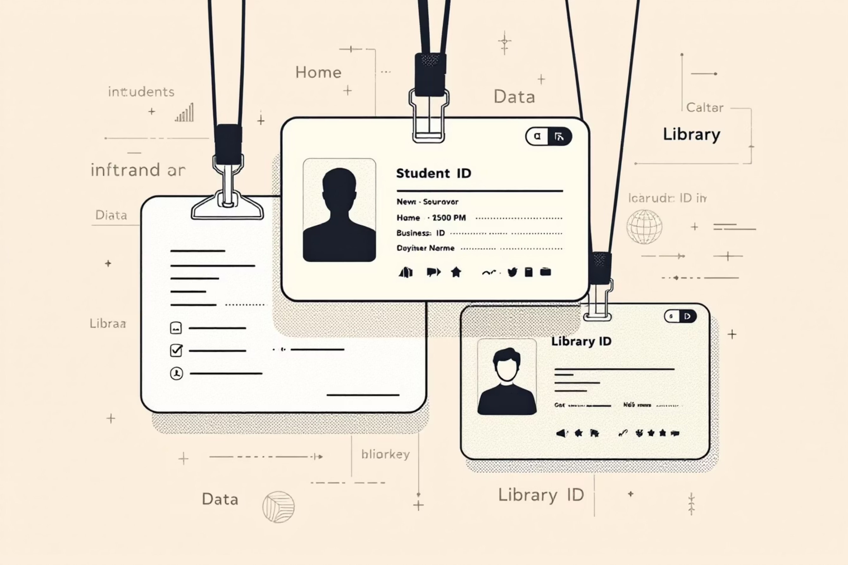
Specialized ID Card Types
The application extends the IDCard base class to create distinct, specialized ID card types, each with its own unique data requirements and display logic.
Student ID Card
Business ID Card
Library ID Card
Roll Number
Position
Member ID
Program & Faculty
Company
Contact Information
Guardian Name
Business Address
Simplified Data Fields
Valid & Expiry Dates
Contact Information

Slide 9




Future Scope and Enhancements
Our application provides a solid foundation, with numerous avenues for future development to enhance its capabilities and user experience.
1
QR/Barcode Integration
2
Database Connectivity
3
GUI Development
4
Cloud Sync
QR/Barcode Integration: Automatically generate and embed QR codes or barcodes for quick scanning and data retrieval.
Database Connectivity: Integrate with local or remote databases (e.g., SQLite, PostgreSQL) to store and manage ID card data more robustly.
GUI Development: Transition from a console-based interface to a modern graphical user interface using frameworks like Qt or MFC for improved usability.
Cloud Sync: Implement cloud synchronization for secure backup and multi-device access to ID card data.

Slide 10
Thank You!!

